Slide 1
NLP and Text Mining for I/O Psychologists
SIOP Master Tutorial
April 26, 2017
Andrea Kropp
Cory Kind
Allison Yost

Slide 2

Today’s Session
Purpose: Provide an introduction to natural language processing and text mining
Intended Audience: Experienced, quantitatively-oriented I/O Psychologists who are interested in working with “words as data.” Familiarity with R is beneficial.
What we will share:
Tools to get started
Our processes
Lessons learned
Example R code
Today’s tutorial is part of the Reproducible Research track. All data, R code, and supporting materials (including video tutorials) can be found here: https://github.com/andreakropp/SIOP2017-NLPTutorial

Slide 3
What to Expect
This session does NOT contain:
A comprehensive introduction to R.
A comprehensive introduction to natural language processing (NLP).
A survey of all available text mining tools and techniques.
A survey of all types of suitable research questions.
This session will contain:
Case studies drawn from the presenters’ own work.
Stories from the trenches – the real-world obstacles encountered and solutions found.
Working code to demonstrate selected ways (among many options) for preparing and analyzing text.
Advice for how to get started yourself and critical questions to ask when evaluating tools, software or vendors.
Notes:
Rather than tackle the (impossible) task of providing a full introduction to NLP/text mining in 80 minutes, the session will provide the audience with the tools to get started by sharing structured case studies and common challenges. The presenters will share their process and lessons learned from the design and execution of studies in the following areas:
Predicting personality and cognitive ability from an individual’s writing
Developing predictive models of performance and tenure from job application responses, and
Extracting topics of concern and sentiment from free-text employee survey responses.

Slide 4
Learning Objectives
Identify organizational research questions well-suited for text analysis and surface the available sources of words/text at your organization.
Recognize the pros and cons of various pre-processing steps, such as speech-to-text conversion, translation to other languages, fuzzy matching or error correction.
Recognize the vocabulary associated with basic NLP transformations and give an example of each, including:
Tokenizing
Stemming
Unigrams and n-gram counting
Part-of-speech tagging
Recognize terms for more advanced text mining techniques and give an example of the type of analysis that would use each approach:
Topic classification
Sentiment classification
Pattern learning
Become aware of common open-source methods for conducting text analyses.
Become aware of educational resources to become more proficient at text analysis.
Create a list of questions that all vendors offering NLP-based solutions should be able to answer about how their service works.

Slide 5
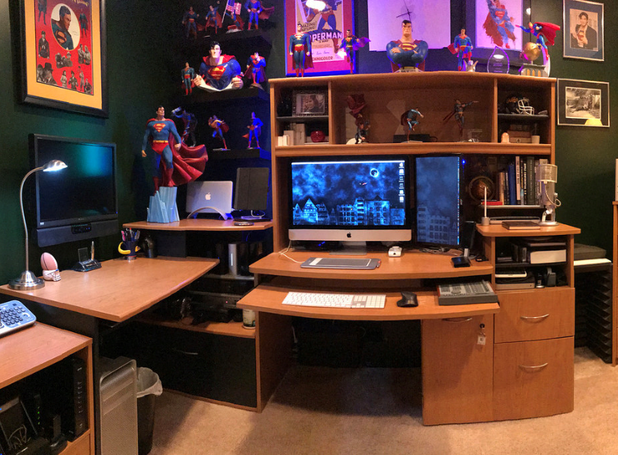

Slide 6
Behavioral Residue
Sam Gosling (University of Texas)
Predicts people’s personalities by looking at their offices, bedrooms, book collections, and music collections.
People are pretty accurate in assessing personality based on these cues.
Correlations range between .14 for emotional stability to .51 for openness.
Traditional Colors
Low Openness
High Tech
Techy, Intelligent
Superman
Comic Books - Introverted
Clean
Conscientious
See Pennebaker (2011) and Gosling et al. (2002)

Slide 7
Written Words are Also a Form of Behavioral Residue
Content Words = nouns, regular verbs, adjectives
Function Words = pronouns (I, you, we, they), articles (a, an, the), prepositions (to, for, over)
Word usage generally reflects psychological state rather than influencing it.
What you say – content words reveal what people pay attention to; what issues are important, values, goals
How you say it – “function” words reveal how people connect to others, think about themselves and their worlds
Example Findings from the Literature on Language Use and Personality
Agreeableness
Positive emotion
Conscientiousness
Time
Extraversion
Social processes
Family
Friends
1st person pronouns (e.g., I)
Exclamation points
1st person plural (e.g., we)
Work
Achievement
Positive emotion
Prepositions (to, for, over)
(-) pronouns, negative emotion, past tense verbs
Family
Friends
Romance
1st person plural (we)
3rd person pronouns (he, she)
Word count
Positive emotion
Anger, negations, swear words (-)
Word length, articles (-)

Slide 8



Relevance of Language for I/O Psychology
Leaders and Employees use language to:
Convey ideas
Solve problems
Negotiate
Socialize
Express dissatisfaction
Traditional I/O Psychology Research Relies Primarily on Quantitative Data
Assessments
Surveys
Performance measures
The qualitative research that does exists typically relies on hand-coding and manual identification of themes
Psychologists and other researchers are starting to use natural language processing (NLP) and other text mining techniques
More and more vendors are offering NLP services to mine employee data

Slide 9







NLP is Growing in Talent Analytics
Organizations are using NLP to:
Screen and Assess Candidates
Continuously Measure Employee Engagement
Detect Fraudulent Behavior
Analyze Open-Text Survey Questions
Gauge reactions to organizational change
Predict Turnover
Recruit Job Applicants
Notes:
https://hbr.org/2016/01/sentiment-analysis-can-do-more-than-prevent-fraud-and-turnover
https://www.wsj.com/articles/how-do-employees-really-feel-about-their-companies-1444788408
https://www.theatlantic.com/technology/archive/2016/09/the-algorithms-that-tell-bosses-how-employees-feel/502064/

Slide 10


NLP in a Nutshell
Clean
Quantify
Analyze
Where we turn words into hundreds, often thousands of quantitative variables…and we’re closer to our comfort zone!

Slide 11
Structure of Today’s Session
1 | How to clean and prepare text data for analysis
2 | Case Studies Predicting personality and cognitive ability from writing samples Extracting topics and sentiment from free-text employee survey questions
3 | Additional Resources

Slide 12
Orientation to the Shared Data Set

Slide 13
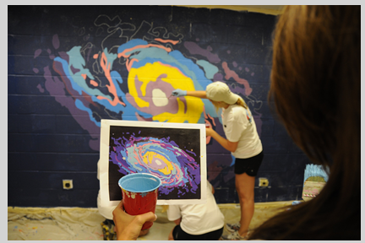
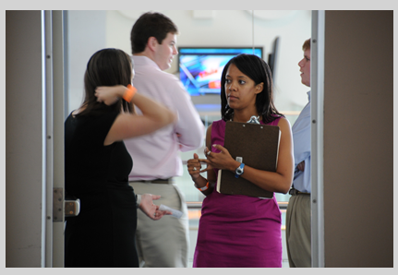
Picture Description Task
INSTRUCTIONS: Describe this picture to someone who has never seen it.
In the foreground of the picture a person, with long brown hair, holds a picture in her hand, along with a red solo cup that appears to have light blue paint in it. The picture that the person is holding looks like a colorful image of a galaxy you would find in space. …
The focal point of this picture is definitely a piece of artwork in the form of a mural. The mural is very colorful, using colors like orange, yellow, blue, purple and dark blue in a highly contrasting fashion. The colors swirl in an almost cosmic looking shape. …
The picture shows three women, two of whom are painting a mural on a cinder block wall. Both painters are wearing white t shirts and black shorts. The painters have their backs turned towards the camera leaving their face not visible. …
Four people are in a room. I can see them through a doorway. It appears to be two women talking to each other and two men conversing with each other. Since they have their backs to each other, this is not a group discussion but two individual pairs. One woman appears to be on her way out the door, because she seems to be partially blocking the entranceway.
At the doorway to the break room at work, an employee in a black dress asks a question of the HR Rep in the purple dress who is carrying a clipboard. In the background, there are two male employees, who are dressed in business casual attire, facing towards a television that has been placed up on the wall. The television is a flat screen, and appears to be showing some sort of news logo.
Four young professionals are standing near a doorway. Two young men are conversing with each other, in the background. The men appear to be caucasian and wearing bussiness attire clothing; long sleeve shirts that are pale pink and blue, and kahki pants. In front of the men are two young women, who also are conversing with each other.

Slide 14

Verify Deductive Reasoning Test
“The Verify Deductive Reasoning test is designed to measure the ability to draw logical conclusions based on information provided, identify strengths and weaknesses of arguments, and complete scenarios using incomplete information. It provides an indication of how an individual will perform when asked to develop solutions based on presented information and draw sound conclusions from data. This form of reasoning is commonly required to support work and decision-making in many different types of jobs at a variety of levels.
“Candidates are presented with 18 questions. They have 20 minutes to answer all of the questions. Due to the adaptive or dynamic nature of the test administration, virtually every candidate will see a different set of questions, which alleviates the typical security concern with the use of cognitive ability tests in an unsupervised setting.
“Normative data are available at several job levels for making appropriate comparisons.”

Slide 15
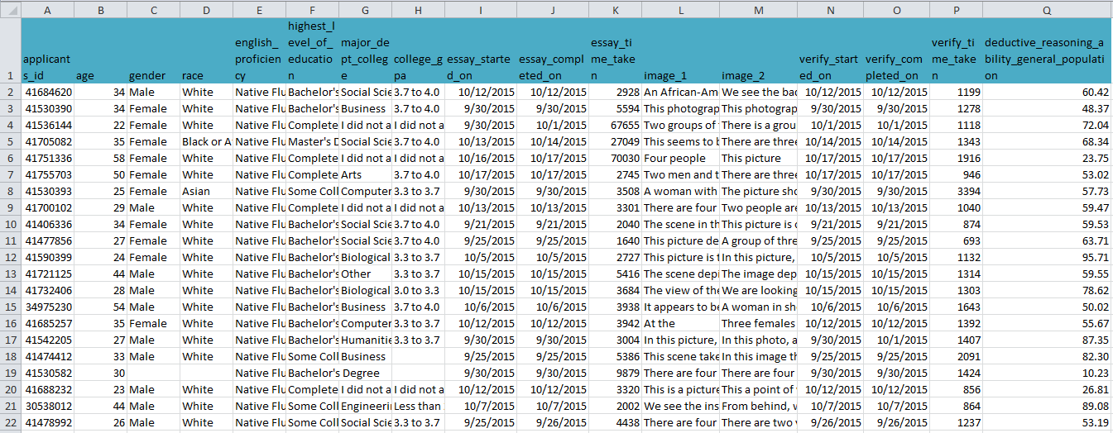
The Data Set
17 columns X 1030 rows
3. Assessment percentile
1. Demographics and classifiers
2. Complete, unaltered text responses

Slide 16
Complete Video Tutorial
25 minutes
4 R scripts
Load and Clean
Text Basics
Words and Phrases
Apply Dictionaries
Available at:
https://github.com/andreakropp/SIOP2017-NLPTutorial
https://www.youtube.com/playlist?list=PLOYA960WeSzqIQK6-Kjd41VsXKY2sS_W9

Slide 17
Case Study:
Predicting Deductive Reasoning Ability from a Picture Description Task

Slide 18
Case Synopsis: Situation – Action – Result
Situation:
It is not always feasible or desirable to administer psychometric assessments.
Organizations would like to have the ability to passively assess candidates.
One possible approach is via an analysis of their written or spoken words.
Action:
In late 2015 CEB researchers conducted a study on Mechanical Turk where >1000 participants responded to 7 writing prompts and sat for 2 assessments.
We analyzed the prompts separately and together to discover which language usage patterns related to which cognitive and personality traits.
Result:
This work is ongoing.
Results to be discussed today include a 0.38 cross-validated Pearson R correlation between language use and Deductive Reasoning assessment scores and a 0.31 cross-validated correlation between language use and the Big Five Achieving facet.

Slide 19

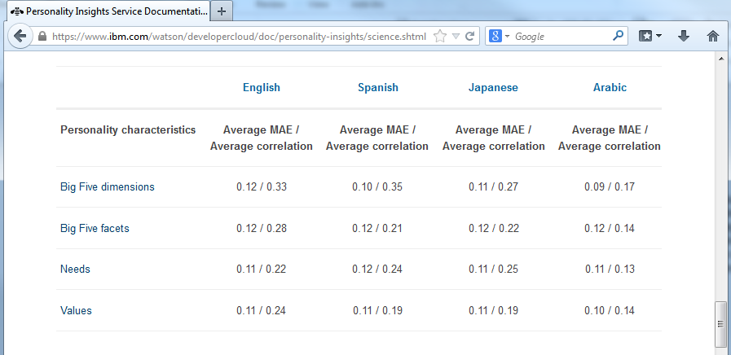
Results vs IBM Watson Personality Insights
Results to be discussed today:
Deductive Reasoning: 0.38 correlation
Big 5 Facet - Achieving: 0.31 correlation
Source: https://www.ibm.com/watson/developercloud/doc/personality-insights/science.shtml, image taken March 17, 2017

Slide 20
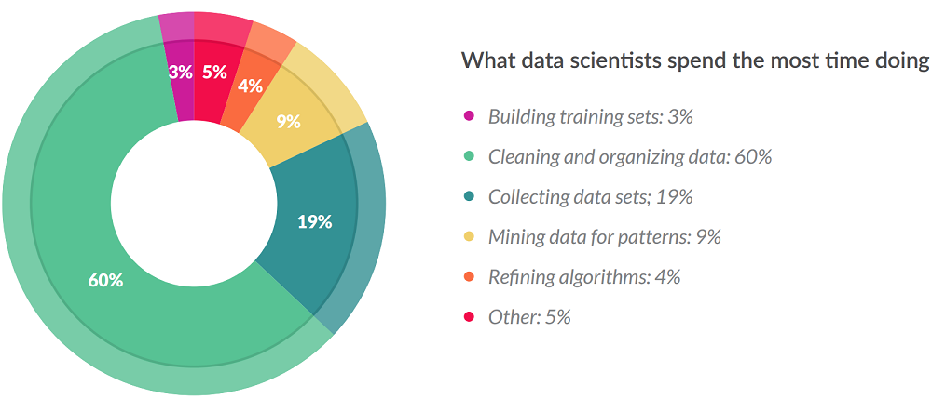
For Great Results, Clean and Prepare it Right!
Care and attention to detail during the text cleaning and feature extraction is how you will achieve success with natural language research projects.
Embrace the fact that text will be messier than the messiest numerical data set you’ve ever worked with.

Slide 21
Learning Objectives from This Case
Preparing your text data for predictive modeling success
Text cleaning and pre-processing considerations and techniques
Translation
Misspellings and alternate spellings
Punctuation
Tokenization (with or without stemming)
Creating numerical variables (features) out of text:
Punctuation
N-gram counting
Readability formulas
Application of word lists

Slide 22
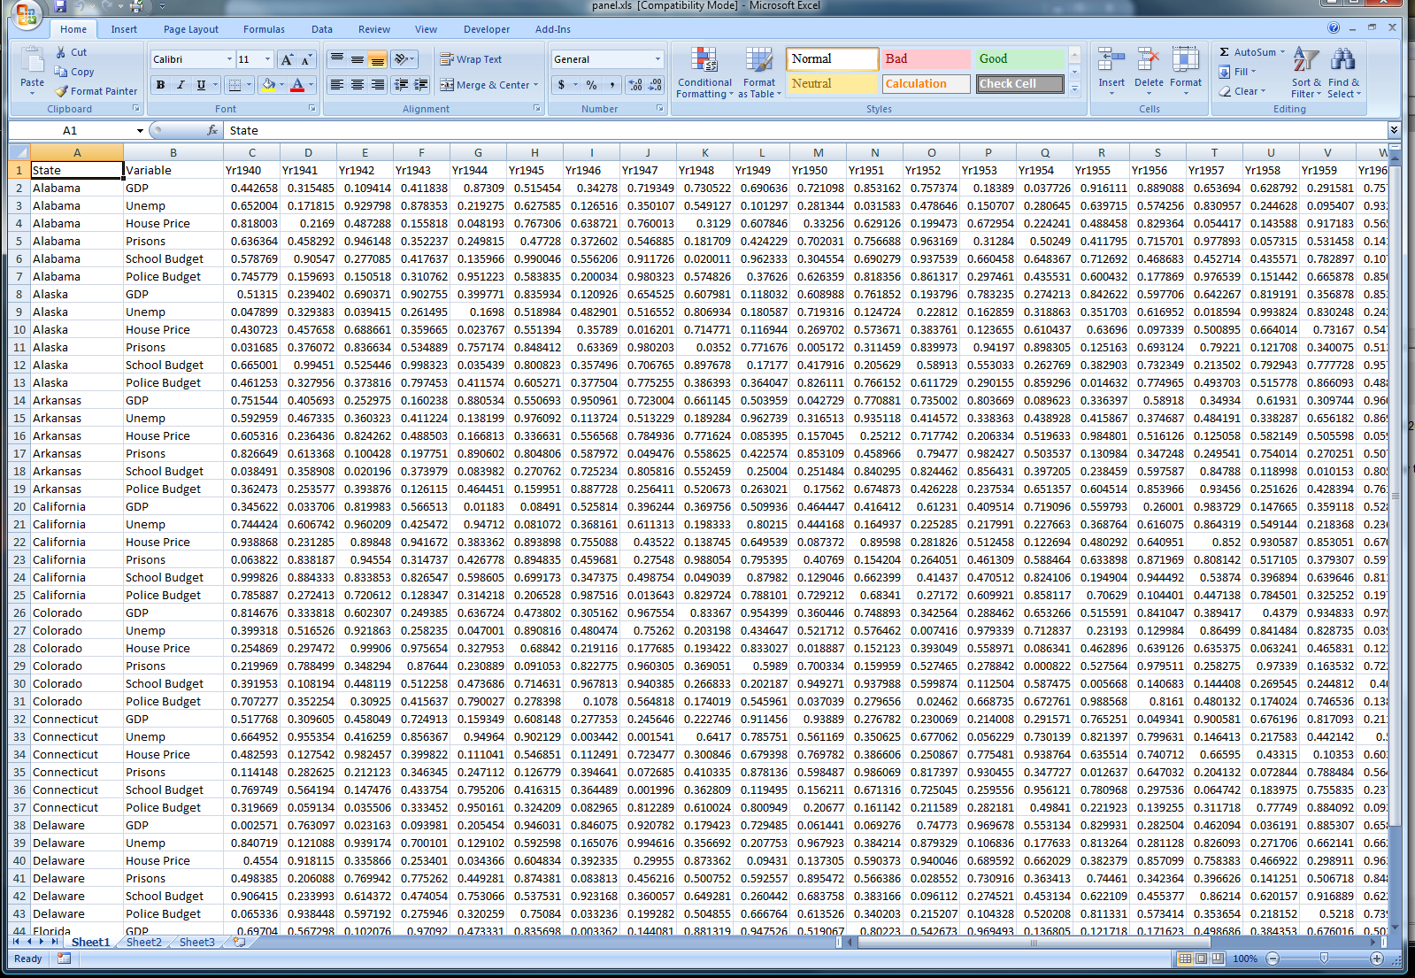
NLP is How You Build Your Data Set
Build up the data set section by section by applying additional transformations to the text.
ID
Verbatim Text
The final data set may be several thousand (or tens of thousands) of columns!
Basic
Counts &
Readability
~15
Parts
of
Speech
~40
Punct-
uation
~20
N-grams
~5000
Dictionaries
~2000
Topics
~50-500
Notes:
Natural language processing generally isn’t an analysis method in and of itself, but rather how to build up your data file for analysis via familiar numerical methods such as regression or classification.

Slide 23
Translation
Don’t do it. Analyze the text in the original language wherever possible.

Slide 24
Alternate Spellings & Misspellings
Source of Variation | Type | Examples
British/ American English | Alternate Spellings | Labor vs labour Theater vs theatre
British/ American English | Alternate Vocabulary | Americans go on vacation, while Brits go on holidays.
Hypenation | Hyphens | e-mail vs email co-worker vs coworker
Contractions | Contractions | Can’t vs cannot Won’t vs would not Doesn’t vs does not
Misspellings | Typo | busimess, supervidor
Misspellings | Error | thier, excede, equiptment

Slide 25
Punctuation Headaches
Source of Variation | Type | Examples
Periods which do not indicate the end of a sentence. | Abbreviations | Mr., Mrs., Dr. Rm. 1010
Periods which do not indicate the end of a sentence. | Punctuated Abbreviations | Ph.D. vs PhD A.M. vs AM
Periods which do not indicate the end of a sentence. | Embedded in Numerals | $100.00 4.0 GPA
Commas which do not separate words. | Embedded in Numerals | 10,000
Slashes | Various | 24/7 blue/green he/she

Slide 26
Automated Cleaning vs DIY
There are many existing natural language processing packages and functions in R.
These functions will perform common tasks such as removing punctuation, removing stop words, tokenizing, counting sentences and calculating readability score based on a set of rules and assumptions selected by the package author.
You may find one that handles these tasks exactly the way you want or you may want to write your own to have more control.
In our project, we wrote our own rules for many tasks. The text cleaning code we have shared uses mostly base R.

Slide 27
Raw
> data$all_text_clean[5] [1] "Four people are in a room. I can see them through a doorway. It appears to be two women talking to each other and two men conversing with each other. Since they have their backs to each other, this is not a group discussion but two individual pairs. One woman appears to be on her way out the door, because she seems to be partially blocking the entranceway. \n\nAll four participants appear to be in a professional setting. All are in professional attire and one woman has a clipboard but has it against her chest and doesn't appear to be using it in the conversation. The other woman has a bright orange wrist band that may possibly be a bracelet & has what appears to be a small piece of paper in the other hand. I can't see if the men have anything in their hands, because they either have their backs to me or are blocked by the women that are in the forefront of the picture.\n\nIt appears to have at least one or more video screens high up the wall in the background but it is hard to see inside the room with the doors and participants blocking the view of the room. One video screen is brightly colored in blue and pink colors but I can't make out any picture on the screen. The door and walls appear to be panels rather than fixed walls, the type of panels found in office cubicles. This picture has a person (possibly a man) in a side profile wearing blue shorts and a light yellow or tan Tshirt and a tan baseball type cap on backwards. This person is recreating a mural on the back wall which has a dark blue (or black) background. There also appears to be two outlets in tan on either side of the mural. The floor appears to have a tan drop cloth. The mural appears to be an abstract galaxy with colors swirling in an offset eye shaped pattern. The center of the &quot;eye&quot; is white with mauve encircling the white &quot;eye&quot; with four whirling rays giving the sense of motion on a background of egg yolk colored yellow. Beyond the yellow, are slim patches of concentric colors of various blues, purples & a hot pink. These areas surround the main &quot;eye&quot; giving the painting a feel of hurricane like movement.\n\nIn the forefront of the picture, I see almost a dark black shadow of a person but in their hand (which is clearly shown) is a red plastic cup of baby blue paint that appears to have been used in the painting and a used brush with the same blue paint appears beyond the shadow. I assume it is being held by the shadow person. Also it appears that the visible hand, behind the red cup, is holding a picture of what is to be recreated on the wall. There is a strange sense of duality with the two pictures in the picture. The wall mural doesn't seem to be an exact copy of the picture but the colors & movement seem a fairly good replication. The small &quot;original&quot; picture seems to have more of an angular slant to it but the wall mural appears to be still in process and it may be more like the original in the final product.\n\nAlmost hidden at the bottom of the picture and behind the &quot;original&quot; picture is a worker sitting on their knees with the same clothing as the standing painter, but the head, shoulders are obliterated by the held picture. I assume this is a woman due to the wider hips, but it may be a man.\n\n "

Slide 28
Clean
> data$all_text_clean[5] [1] "FOUR PEOPLE ARE IN A ROOM I CAN SEE THEM THROUGH A DOORWAY IT APPEARS TO BE TWO WOMEN TALKING TO EACH OTHER AND TWO MEN CONVERSING WITH EACH OTHER SINCE THEY HAVE THEIR BACKS TO EACH OTHER THIS IS NOT A GROUP DISCUSSION BUT TWO INDIVIDUAL PAIRS ONE WOMAN APPEARS TO BE ON HER WAY OUT THE DOOR BECAUSE SHE SEEMS TO BE PARTIALLY BLOCKING THE ENTRANCEWAY ALL FOUR PARTICIPANTS APPEAR TO BE IN A PROFESSIONAL SETTING ALL ARE IN PROFESSIONAL ATTIRE AND ONE WOMAN HAS A CLIPBOARD BUT HAS IT AGAINST HER CHEST AND DOESN'T APPEAR TO BE USING IT IN THE CONVERSATION THE OTHER WOMAN HAS A BRIGHT ORANGE WRIST BAND THAT MAY POSSIBLY BE A BRACELET AND HAS WHAT APPEARS TO BE A SMALL PIECE OF PAPER IN THE OTHER HAND I CAN'T SEE IF THE MEN HAVE ANYTHING IN THEIR HANDS BECAUSE THEY EITHER HAVE THEIR BACKS TO ME OR ARE BLOCKED BY THE WOMEN THAT ARE IN THE FOREFRONT OF THE PICTURE IT APPEARS TO HAVE AT LEAST ONE OR MORE VIDEO SCREENS HIGH UP THE WALL IN THE BACKGROUND BUT IT IS HARD TO SEE INSIDE THE ROOM WITH THE DOORS AND PARTICIPANTS BLOCKING THE VIEW OF THE ROOM ONE VIDEO SCREEN IS BRIGHTLY COLORED IN BLUE AND PINK COLORS BUT I CAN'T MAKE OUT ANY PICTURE ON THE SCREEN THE DOOR AND WALLS APPEAR TO BE PANELS RATHER THAN FIXED WALLS THE TYPE OF PANELS FOUND IN OFFICE CUBICLES THIS PICTURE HAS A PERSON POSSIBLY A MAN IN A SIDE PROFILE WEARING BLUE SHORTS AND A LIGHT YELLOW OR TAN TSHIRT AND A TAN BASEBALL TYPE CAP ON BACKWARDS THIS PERSON IS RECREATING A MURAL ON THE BACK WALL WHICH HAS A DARK BLUE OR BLACK BACKGROUND THERE ALSO APPEARS TO BE TWO OUTLETS IN TAN ON EITHER SIDE OF THE MURAL THE FLOOR APPEARS TO HAVE A TAN DROP CLOTH THE MURAL APPEARS TO BE AN ABSTRACT GALAXY WITH COLORS SWIRLING IN AN OFFSET EYE SHAPED PATTERN THE CENTER OF THE EYE IS WHITE WITH MAUVE ENCIRCLING THE WHITE EYE WITH FOUR WHIRLING RAYS GIVING THE SENSE OF MOTION ON A BACKGROUND OF EGG YOLK COLORED YELLOW BEYOND THE YELLOW ARE SLIM PATCHES OF CONCENTRIC COLORS OF VARIOUS BLUES PURPLES AND A HOT PINK THESE AREAS SURROUND THE MAIN EYE GIVING THE PAINTING A FEEL OF HURRICANE LIKE MOVEMENT IN THE FOREFRONT OF THE PICTURE I SEE ALMOST A DARK BLACK SHADOW OF A PERSON BUT IN THEIR HAND WHICH IS CLEARLY SHOWN IS A RED PLASTIC CUP OF BABY BLUE PAINT THAT APPEARS TO HAVE BEEN USED IN THE PAINTING AND A USED BRUSH WITH THE SAME BLUE PAINT APPEARS BEYOND THE SHADOW I ASSUME IT IS BEING HELD BY THE SHADOW PERSON ALSO IT APPEARS THAT THE VISIBLE HAND BEHIND THE RED CUP IS HOLDING A PICTURE OF WHAT IS TO BE RECREATED ON THE WALL THERE IS A STRANGE SENSE OF DUALITY WITH THE TWO PICTURES IN THE PICTURE THE WALL MURAL DOESN'T SEEM TO BE AN EXACT COPY OF THE PICTURE BUT THE COLORS AND MOVEMENT SEEM A FAIRLY GOOD REPLICATION THE SMALL ORIGINAL PICTURE SEEMS TO HAVE MORE OF AN ANGULAR SLANT TO IT BUT THE WALL MURAL APPEARS TO BE STILL IN PROCESS AND IT MAY BE MORE LIKE THE ORIGINAL IN THE FINAL PRODUCT ALMOST HIDDEN AT THE BOTTOM OF THE PICTURE AND BEHIND THE ORIGINAL PICTURE IS A WORKER SITTING ON THEIR KNEES WITH THE SAME CLOTHING AS THE STANDING PAINTER BUT THE HEAD SHOULDERS ARE OBLITERATED BY THE HELD PICTURE I ASSUME THIS IS A WOMAN DUE TO THE WIDER HIPS BUT IT MAY BE A MAN DOLLAR"

Slide 29
Sample Cleaning Sequence
#remove system-generated characters
data$all_text_clean <- gsub("\\n\\n","", data$all_text_clean, perl = TRUE)
data$all_text_clean <- gsub("&quot;","", data$all_text_clean, perl = TRUE)
#replace symbols with meaning
data$all_text_clean <- gsub("&"," and ", data$all_text_clean, perl = TRUE)
data$all_text_clean <- gsub("%"," percent ", data$all_text_clean, perl = TRUE)
#remove between word dashes
data$all_text_clean <- gsub(" - "," ", data$all_text_clean, perl = TRUE)
#remove all punctuation except apostrophes and intra-word dashes,
data$all_text_clean <- gsub("[^[:alnum:]['-]", " ", data$all_text_clean, perl = TRUE)
#remove double whitespaces and final whitespace
data$all_text_clean <- gsub(" *", " ", data$all_text_clean, perl = TRUE)
data$all_text_clean <- gsub(" $", "", data$all_text_clean, perl = TRUE)
#convert all text to upper case
data$all_text_clean <- toupper(data$all_text_clean)

Slide 30
Tokenization and N-Gram Counting
There are existing R functions to tokenize your text.
In our project, we used the strsplit() string split function on every white space character after removing punctuation and extra white spaces.
We break each cleaned full text response into a list of individual words.
From this list we can count:
The total number of words
The total number of unique words
The frequency for each unique word

Slide 31
Process Overview
List of
unique
words
to be
counted
Combine all
responses
Find all unique
words used
Filter to reduce
length (e.g. used
by 2% of authors)
For all
authors
combined
Split clean
text into a
list of words
Count how many
times the author
uses each word
Document-Term
Matrix
Rows = authors
Columns = unique words
Cells = count
Append the
doc-term matrix
to the main
data set
For each
author

Slide 32
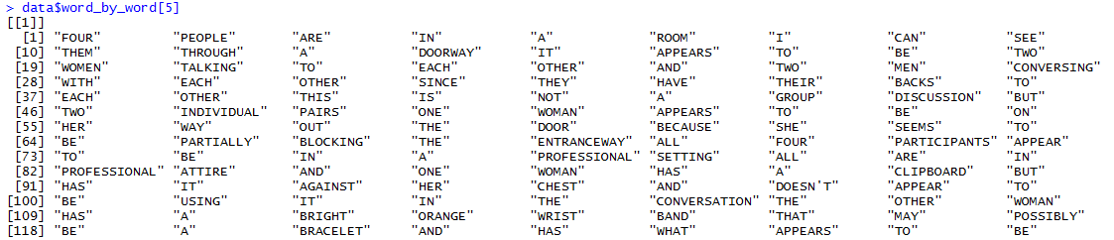
From Clean Text to Variables
> data$all_text_clean[5] [1] "FOUR PEOPLE ARE IN A ROOM I CAN SEE THEM THROUGH A DOORWAY IT APPEARS TO BE TWO WOMEN TALKING TO EACH OTHER AND TWO MEN CONVERSING WITH EACH OTHER SINCE THEY HAVE THEIR BACKS TO EACH OTHER THIS IS NOT A GROUP DISCUSSION BUT TWO INDIVIDUAL PAIRS ONE WOMAN APPEARS TO BE ON HER WAY OUT THE DOOR BECAUSE SHE SEEMS TO BE PARTIALLY BLOCKING THE ENTRANCEWAY ALL FOUR PARTICIPANTS APPEAR TO BE IN A PROFESSIONAL SETTING ALL ARE IN PROFESSIONAL ATTIRE AND ONE WOMAN HAS A CLIPBOARD BUT HAS IT AGAINST HER CHEST AND DOESN'T APPEAR TO BE USING IT IN THE CONVERSATION THE OTHER WOMAN HAS A BRIGHT ORANGE WRIST BAND THAT MAY POSSIBLY BE A BRACELET AND HAS WHAT APPEARS TO BE
Word count
Unique word count
Frequency of each unique word
+more

Slide 33
Summary Statistics
1030 different authors
386,353 total words
Top 20 Words
Word | Count
THE | 31759
A | 18999
IS | 16776
AND | 10676
OF | 10132
IN | 9980
TO | 8715
ARE | 7129
ON | 6026
HER | 5207
SHE | 4493
WOMAN | 4198
BE | 4154
WITH | 4150
WEARING | 3436
TWO | 3347
BLUE | 3280
THAT | 3190
PICTURE | 3111
IT | 3104
Words Remaining at Various Frequency Thresholds
Cutoff | Unique Words Remaining | Total Words Remaining
None | 8871 | 386,353
2 different authors | 4421 | 381,932
1% of authors (>10) | 1412 | 370,065
2% of authors (>20) | 987 | 363,855
5% of authors (>51) | 574 | 350,339
10% of authors (>102) | 376 | 335,838

Slide 34
Word Lists & Dictionaries
In this context, a dictionary is simply a list of words or words and phrases.
There are existing dictionaries (aka word lists) you can apply to your text
Roget
WordNet
LIWC
+others
Sentiment dictionaries are a special type of dictionary where the words are placed on separate lists based on whether they have a positive or negative connotation and their intensity.
Strongly positive = wonderful, fabulous, world class
Positive = nice, good, pleasant
Negative = so-so, bland, uninteresting
Strongly negative = awful, disastrous, pile of rubbish
Researchers can and should write their own word lists to investigate specific hypotheses.

Slide 35
Sample Organizing Principles for Dictionaries
Stem-based
Function-based
Meaning-based
Theme-based
Achieve
Achieves
Achieving
Achieved
Achievement
Achievements
Achiever
Overachieve
Overachiever
Overachievers
Overachieving
Underachieve
Underachiever
Underachieves
Underachieving
Right
Left
Above
On top of
Below
Beneath
Beside
Under
Across
Behind
In front of
Next to
Bad
Awful
Lousy
Unacceptable
Atrocious
Crummy
Dreadful
Horrible
Terrible
Cruddy
Substandard
Basketball
Dribble
Dunk
Guard
Center
Sports
Football
Tennis
Golf
Gymnastics
Leisure
Music
Theatre
Travel
Books

Slide 36
Hypothesis Driven Custom Word Lists
List Name | Sample Words on List
People - Generic | ADULT, BOY, CHARACTERS, CONVERSATIONALISTS, EVERYBODY, EVERYONE, FEMALE, GALS, GENTLEMAN, GENTLEMEN, GIRL, GIRLS, GROUP, GUYS, HE
People - Self | I, ME, US, WE
People - Names | ANGELA, ANGIE, CLARISSA, CYNTHIA, DAN, DANNY, DARREN, DAVE, DAWN, DEBBIE, DEVYN, DJ, EMILY, HOWARD, JAMES, JAN, JANE
People - External | AUDIENCE, CAMERAMAN, CAMERAMEN, ONLOOKER, ONLOOKERS, PHOTOGRAPHER
People – No Projections | ARTIST, ARTISTS, BUSINESSMAN, BUSINESSMEN, BUSINESSWOMAN, BUSINESSWOMEN, COLLEAGUE, COLLEAGUES, COWORKER, EMPLOYEE, MURALIST, PAINTER, WORKER
People – With Projections | ADMINISTRATOR, ADVISOR, AIDE, ASSISTANT, BOSS, CEO, CLERK, CLIENT, COORDINATOR, CUSTODIAN, CUSTOMER, DAD, DAUGHTER, DIRECTOR, ENGINEER, EXECUTIVE, FRIEND

Slide 37
Prepared Data Set
Code we have provided will result in a data frame 1030 rows x 1339 columns (starting from 17 columns)
The data set is now ready for predictive modeling.
In our complete research (not shared) we generated > 13,000 new language features before beginning to model.

Slide 38
Exploratory Analysis Suggestions
Examine how strongly each language feature relates to your outcome
Examine the group-level difference in each language feature.

Slide 39
Most Predictive Individual Features
58 features with Pearson R correlation > 0.15
ngram_CLIPBOARD_bin | 0.25
ngram_GALAXY_bin | 0.25
ngram_FOREGROUND_bin | 0.23
ngram_CLIPBOARD | 0.22
ngram_FOREGROUND | 0.21
ngram_OF | 0.21
ngram_THROUGH | 0.20
ngram_THROUGH_bin | 0.20
ngram_A | 0.20
ngram_KHAKIS_bin | 0.20
char_6plus | 0.20
char_5plus | 0.20
ngram_OBSCURED_bin | 0.19
ngram_APPEARS_bin | 0.19
char_7plus | 0.19
misspelling_normalized | -0.18
ngram_FACING_bin | 0.18
char_count | 0.18
ngram_GALAXY | 0.18
ngram_DOLLAR_normalized | -0.18
ngram_OBSCURED | 0.18
unique_word_count | 0.18
ngram_KHAKIS | 0.17
ngram_WEARING | 0.17
syllables | 0.17
ngram_T-SHIRTS | 0.17
ngram_T-SHIRTS_bin | 0.17
word_count | 0.17
ngram_VISIBLE_bin | 0.17
ngram_HAND | 0.17
ngram_VISIBLE | 0.17
char_8plus | 0.17
ngram_AND | 0.17
ngram_HEAD | 0.16
ngram_WOMAN_bin | 0.16
ngram_CAMERA_bin | 0.16
ngram_THE | 0.16
ngram_BASEBALL_bin | 0.16
ngram_BASEBALL | 0.16
ngram_RIGHT | 0.16
ngram_RIGHT_bin | 0.16
ngram_AWAY | 0.16
ngram_FACING | 0.16
ngram_WE_bin | 0.16
ngram_BLONDE_bin | 0.16
ngram_DARK_bin | 0.16
ngram_BLONDE | 0.15
ngram_BACKWARDS_bin | 0.15
ngram_DOORWAY_bin | 0.15
ngram_AWAY_bin | 0.15
ngram_SHORTS_bin | 0.15
ngram_BLUE | 0.15
ngram_BACKWARDS | 0.15
ngram_LEFT_bin | 0.15
ngram_WOMAN'S | 0.15
ngram_WEARING_bin | 0.15
ngram_HER | 0.15
pos_pronouns_first_person_plural_bin | 0.15

Slide 40
Language Features by College Major
Major Department in College | N | Flesch-Kincaid Reading Grade Level
Computer Science | 79 | 7.5
Engineering | 46 | 7.4
Physical Science | 31 | 7.4
Social Science | 129 | 7.3
Arts | 101 | 7.2
Humanities | 126 | 7.2
Business | 152 | 7.1
Other | 78 | 7.1
Biological Science | 63 | 7.0
I did not attend college | 137 | 7.0
Education | 40 | 6.6
Applied Health | 34 | 6.3
Major Department in College | N | Percent Words Misspelled
Biological Science | 63 | 1.3%
Business | 152 | 1.1%
Applied Health | 34 | 1.1%
Arts | 101 | 1.1%
Engineering | 46 | 1.0%
Other | 78 | 1.0%
Social Science | 129 | 1.0%
Education | 40 | 0.9%
I did not attend college | 137 | 0.9%
Physical Science | 31 | 0.9%
Humanities | 126 | 0.9%
Computer Science | 79 | 0.9%

Slide 41
Results from Our Own Analyses
Deductive Reasoning Ability is well predicted from a simple picture description task.
A cross-validated Pearson R correlation of 0.34 between predicted and actual assessment score was achieved with a Random Forest model using the responses from the two picture tasks together. Approx ~400 words per person.
A cross-validated Pearson R correlation of 0.39 between predicted and actual assessment scores was achieved with a Ridge Regression model using responses to the two picture tasks plus 5 more writing prompts. Approx ~1200 words per person.
The Achieving personality trait is well predicted from a custom-designed Achieving word dictionary when it is applied to Self-Reflective writing prompts.
A cross-validated Pearson R correlation of 0.28 between predicted and actual Achieving scores was achieved with a 2 predictor linear regression model using responses to the 4 Self-Reflective writing prompts by applying 2 custom word lists.
A cross-validated Pearson R correlation of 0.33 between predicted and actual Achieving scores was achieved using responses to the 4 Self-Reflective writing prompts by applying the two custom word lists plus several hundred other predictors.

Slide 42
Designer Dictionary for Achieving and its Inverse
Hypothesis-Driven
Positive
R=0.26
579 total words
ACHIEVE
ACHIEVES
ACHIEVING
SUCCESS
SUCCESSFUL
SUCCESSFULLY
FAIL
FAILED
FAILURE
WEAK
WEAKNESS
WEAKNESSES
Actual Score
Predicted Score
Hypothesis-Driven
Negative
R= -0.18
200 total words
ACCIDENT
LAZY
SICK
OBLIGATIONS
MAY
MAYBE
NORMALLY
MOSTLY
BROTHER
SISTER
HUSBAND
WIFE
STAYED
STABLE
CONTENT
MAINTAIN
Actual Score
Other People
Excuses
Status Quo
Non-Committal
Predicted Score

Slide 43
Case Study Recap
How to clean text
How to create thousands of features from cleaned text
Word count
Readability
Part of speech
Dictionaries
Exploring correlations between individual features and outcomes
Feature reduction
Multiple modeling techniques to create prediction equations

Slide 44
Case Study: Extracting Topics and Sentiment from Employee Survey Comments

Slide 45
Case Synopsis: Situation
Situation:
Employees and applicants provide text for many different reasons – to provide suggestions, ask questions, or voice frustrations.
Often, automatic topic tagging is required – looking at a random sample of cases is not comprehensive.
Looking only at pre-defined words or topics (“work-life balance”) might lead you to miss important new ideas or trends (e.g., “MOOC”).

Slide 46
Learning Objectives from This Case
Understand the methodology behind unstructured topic classification and how to identify the right number of topics
Learn about visual tools for exploring topics, in particular the LDAvis and wordcloud R packages
Identify potential use cases for topic modeling

Slide 47
What is Topic Modeling?
Key Assumption: You have a set of documents in which thematic groupings exist. Some people call this an existing “meta-structure” of themes across your documents.
Topics: Each “theme” in this meta-structure is called a topic. Topics are described by a set of words and weights. Formally, “a multinomial distribution over the terms in the vocabulary of the corpus”. Across all the documents, these words appear more often together than you would expect from random chance.
Topic Modeling: Topic modeling is the process of using matrix optimization that extracts those themes from the text through analysis of the co-occurrence of the words across the documents.

Slide 48
How It Works – Bayes Rule
#Generate model with k = 10 topics
ldaOut <-LDA(dtm, 10, method="Gibbs", control=list(seed = seed, best=best))
Process
Randomly assign word weights per topic
For each topic, estimate the “probability” the word is in the topic using the frequency of each word and the other words in the document in the topic
Repeat (a lot), adjusting weights to maximize the cohesion within topics
Vocabulary
Topics
Document-term matrix
(N x V)
Feature Weights
(V x K)
Vocabulary
Documents
N = # of documents (text samples)
V = vocabulary size (# of unique words used)
K = # of topics to extract

Slide 49
Step 1: Clean and Tokenize Your Data
What to Do:
Tokenize words
Remove punctuation
Remove stop words
Upper/lower case
Before
After
“I have been out of work for almost four years. Four months ago, I decided to get at least a part-time job. I checked the want-ads in the Sunday paper every week and had my husband help me make a list of potential employers…”
“work almost four years four months ago decided get at least part-time job checked want-ads sunday paper every week husband help make list potential employers…”

Slide 50
Step 2: Additional (Optional) Cleaning
What to Consider:
Stemming
Lemmatization
Removal of very infrequent words
Before
After
“work almost four years four months ago decided get least part-time job checked want-ads sunday paper every week husband help make list potential employers…”
“work almost four year four month ago decid get least part-tim job check want-ad sunday paper everi week husband help make list potenti employ…”

Slide 51
Why Do These Steps?

Slide 52
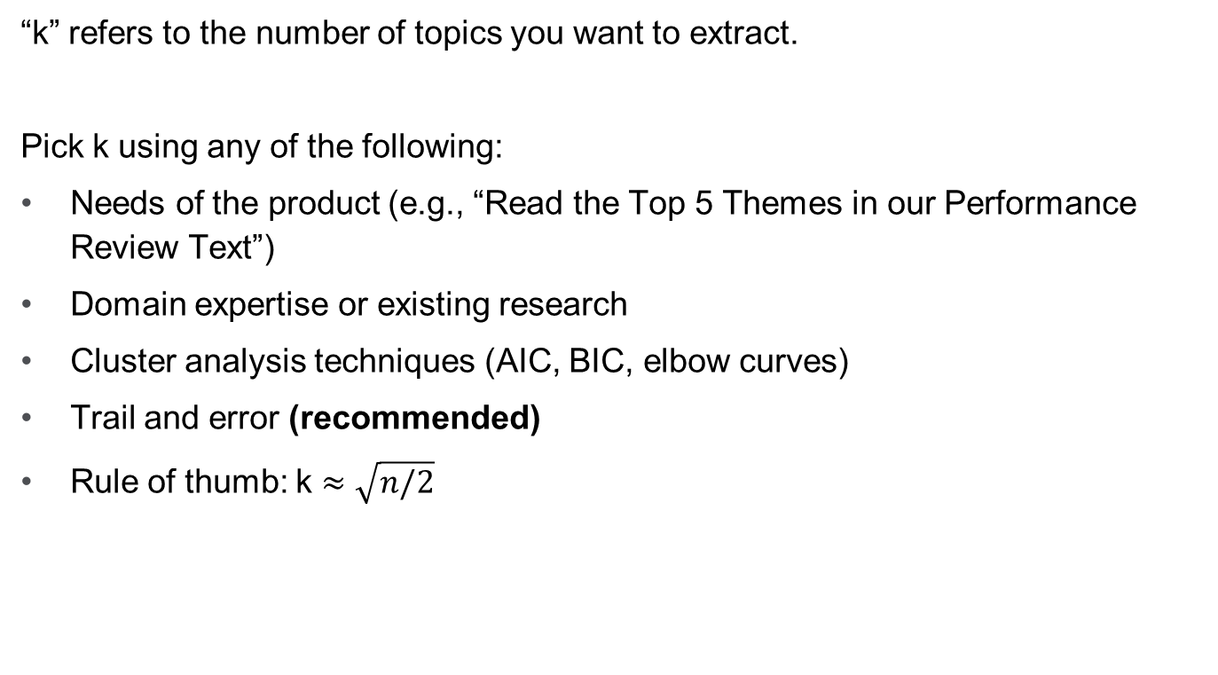
The Art of Choosing K
“k” refers to the number of topics you want to extract.
Pick k using any of the following:
Needs of the product (e.g., “Read the Top 5 Themes in our Performance Review Text”)
Domain expertise or existing research
Cluster analysis techniques (AIC, BIC, elbow curves)
Trail and error (recommended)
Rule of thumb: k ≈ $\sqrt{n/2}$

Slide 53
Topic Modeling on Goals Data
Question:
Describe a major goal you've set for yourself recently. How do you plan to achieve it? What progress have you made?

Slide 54
Topic Modeling on Goals Data
Question:
Describe a major goal you've set for yourself recently. How do you plan to achieve it? What progress have you made?
Answer:
Let’s find out!

Slide 55
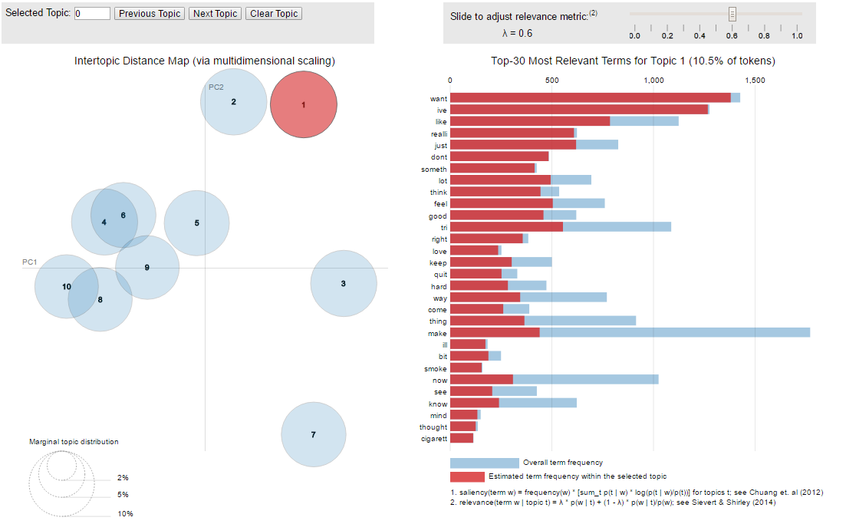
Our First Model (k = 10)
Sievert, Carson and Kenneth Shirley. “LDAvis: A method for visualizing and interpreting topics.”

Slide 56
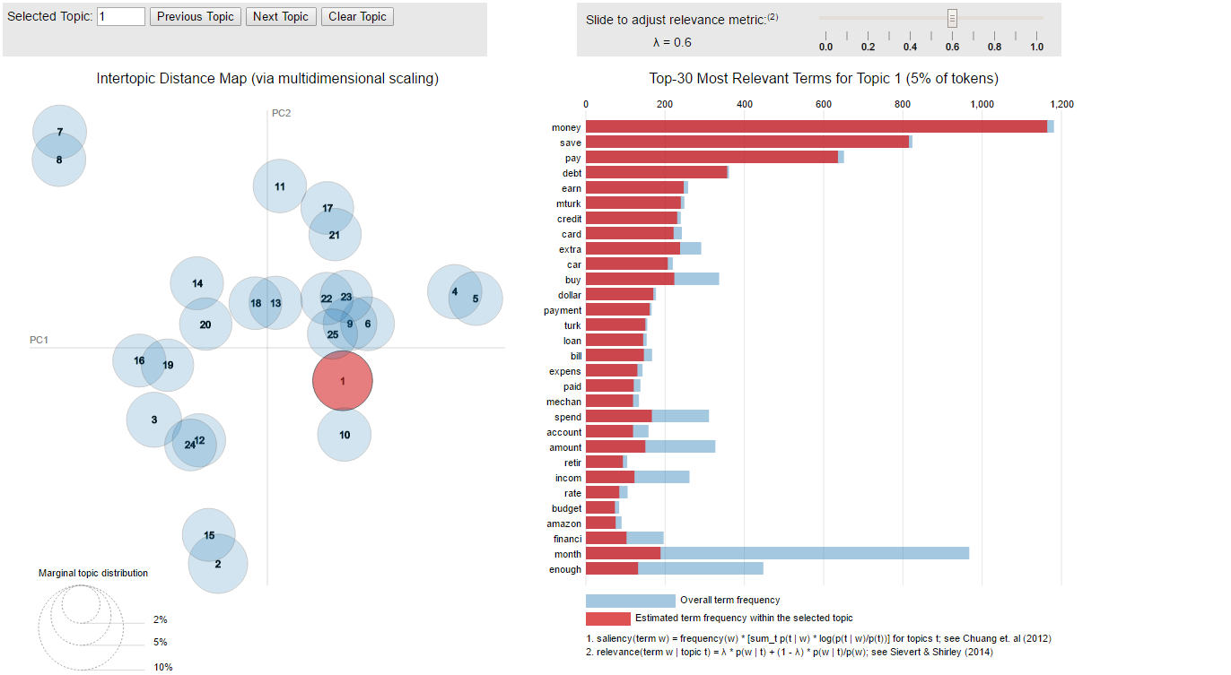
Our Second Model (k = 25)
Sievert, Carson and Kenneth Shirley. “LDAvis: A method for visualizing and interpreting topics.”

Slide 57
Other Ways to Interrogate Topic Models
Methods | Pros | Cons
Read some entries | More detailed Build a better sense of your data | Difficult when you have many topics Hard to directly compare topics
Topic terms and weights | Reveals defining words of the topic | Topics generally use thousands of words Hard to draw meaning without additional context
Word clouds | Builds a sense of the data quickly | Not very actionable Doesn’t contribute to statistical analysis

Slide 58
Sample Entries from Topic 1
“I have type two diabetes. My sugars have been out of control for the last year…I have been making exuses [sic] for why my numbers have been this high thus far. A month ago I went to the doctor. For the first time in my life my doctor said something I had feared hearing. In all the years before there was never a time frame given. This time was different. He looked me straight in the eye and told me if I don't do anything to get these sugars under control, I will be dead in seven to ten years…”
“I've been trying to stay on top of things in my life, however, I've come to the conclusion it is too big of a goal to set for myself at this juncture in my journey of self improvement. I have ADD. I'm 40 years old. I didn't receive a diagnosis of ADD until I was nearly 37 years old, and only after realizing my daughter had the issue, and taking her to a Neurologist for an evaluation, and then struggling with my medical insurance to pay for an evaluation for myself. I now need to undo nearly four decades of issues stemming from undiagnosed ADD, many of which I will never be able to overcome, only manage….”
“I have a problem with anxiety. It has been ongoing for several years. I have had my ups and downs with it. I have gone to therapy and also used medication to treat it…”
“There is something that I am working very hard on. It is the thing that has defined me for over half of my existence. It is my dark passenger, my constant companion. The friend in question is my depression. The goal for the last year has been to work on this…”

Slide 59
Highest Weighted Terms, Topics 1-5
Topic 1 | Topic 2 | Topic 3 | Topic 4 | Topic 5
life | learn | also | ive | weight
goal | use | eat | make | lose
year | creat | tri | keep | exercis
now | skill | food | come | pound
even | well | cut | sure | day
get | can | chang | time | eat
take | play | feel | mani | diet
medic | becom | healthier | enough | walk
doctor | practic | drink | far | lost
never | game | meal | ill | calori
Highest Weights
Lowest Weights

Slide 60
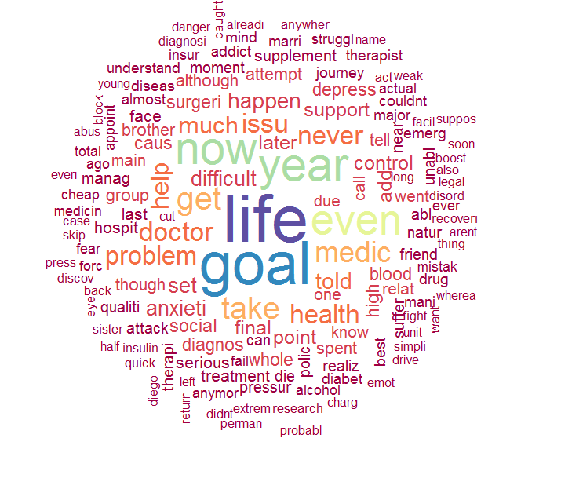
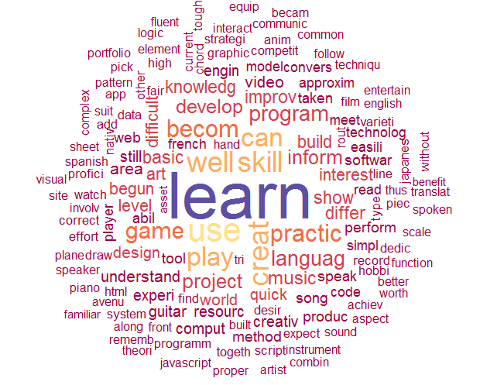
Word Clouds
#Generate word cloud
wordcloud(words = names(word_weights), freq = word_weights, …)
Topic 1: Overcoming Health Problems
Topic 2: Learning Skills (Languages, Music, Code, Video Games)

Slide 61
Example Applications of Topic Modeling
Problem
Free-text responses from employee surveys can be long and detailed. Reading them all is unreasonable, but you don’t want to miss points of frustration or enthusiasm.
Solution
Create a tool to automate topic tagging and sentiment analysis of employee surveys. By applying sentiment dictionaries, we can quickly understand what people are talking about and their sentiment.
Topic 1 (sentiment score: +0.75)
401K
Benefit
Dental
Topic 2 (sentiment score: -0.3)
Career
Development
Promotion

Slide 62
Example Applications of Topic Modeling
Problem
Employees come with past jobs, but knowing a title doesn’t tell you much about what they did while they were there. Some titles are too general, others are arbitrarily different.
“Supervised a team of 15+ sales agents”
“Manager”
“Bartender, front of house duties”
“Homemaker, budget owner, chauffer”
“Customer Representative”
“Call Center Agent”
“Answer incoming calls”
“Sales Representative”
“Phone Operator”

Slide 63
Example Applications of Topic Modeling
Solution
Apply topic modeling to job descriptions or duties, rather than job titles. This can allow you to automatically cluster employees by their past experiences rather than relying on title alone.
Example Past Job Experiences of “Sales Managers”:
Topic 1
Marketing
Analysis
Operations
Forecast
Topic 2
Manage
Performance
Recruit
Line
Topic 3
Customer
Quota
High-Value
Terrain

Slide 64
Additional Resources

Slide 65
Educational Resources
This session! Today’s tutorial is part of the Reproducible Research track. All data, R code, and supporting materials (including video tutorials) can be found here: https://github.com/andreakropp/SIOP2017-NLPTutorial
MOOCs offered on platforms as Udacity and Coursera or directly by leading universities.
Books such as the O’Reilly manuals
Discussion forums such as Stackoverflow.com
Online communities such as R-bloggers.com
Conferences such as PyData

Slide 66
Common Text Handling R Packages
tm
stringR
tidytext
quanteda
koRpus
tokenizers
Ngram
NLP
textcat
readability
Qdapdictionaries
Edgar
wordpools
topicmodels
LDAvis
wordcloud
The functionality of many of these packages overlap one another. Consult the documentation for each package to find the best function for your use case (or write your own).

Slide 67
Considerations When Searching for NLP Software
If you haven’t started yet, strongly consider using all open-source!
PROS
Free
Constantly improving (for free)
Many templates, discussion forums, and courses available
Full control over the analysis
Easier for your IT team to deploy
CONS
Lacks a point-and-click user interface
May have a steeper initial learning curve depending on the skills already available in your group

Slide 68
Places to Look for Text Analytics Talent
Your IT department: Look for staff with experience in writing code for data analysis or data visualization.
Your marketing department: Look for staff with experience analyzing free-text customer feedback or sentiment or recurring topics.
Your junior HR staff: You’d be amazed how many people have taken at least one coding class for fun or in school
Your local university in Information Science, Linguistics, Communications or Marketing departments.
Inside MOOCs and on discussion forums

Slide 69
Evaluating NLP Solution Providers
If you plan to purchase an end-to-end solution or custom text analytics engagement, be sure to ask these questions:
What data was used to develop the language models? TIP: Stay away from models trained on personal communications (e.g. Twitter, personal emails, or text messages) which are being applied to business communications (job interviews, sales meeting notes, engagement surveys, etc.)
Can you analyze the text in the original language or will translation be required?
What proprietary dictionaries, topic models, sentiment dictionaries or ontologies will you be applying and how does it compare to other vendors? TIP: Stay away from vendors who only count words and don’t offer any methods for finding or classifying themes.
How do you evaluate the performance of your language models? TIP: Ask to see the cross-validation results for all custom models they develop for you. Better yet, only send them 75% of your data and run your own validation on the remaining 25%.

Slide 70
Cory Kind, Research Scientist, ckind@cebglobal.com
Andrea Kropp, Senior Research Scientist kroppa@cebglobal.com
Allison Yost, Ph.D., Senior Research Scientist ayost@cebglobal.com

